Slide 1
PAEDIATRIC ASTHMA INHALER GUIDELINE CHILDREN AGED 12+
Diagnosis of childhood asthma is not covered in this guidance
CONSIDER GREENER INHALER CHOICES
The primary consideration for all children and young people should be ACHIEVING GOOD ASTHMA CONTROL!
For this reason, Metered-dose Inhalers (MDIs) delivered via a spacer are currently the preferred devices in most children and young people, at least until their asthma is stable and well controlled.
However, it is widely recognised that Dry Powder Inhalers (DPIs) have a 5-10x smaller carbon footprint than Metered-Dose (MDIs) and Breath-Actuated Inhalers (BAIs). This is because DPIs do not contain a hydrofluoroalkane (HFA) propellant that acts as a powerful greenhouse gas.
With carbon emissions and the environment in mind, you can consider treating older children (>12 years) with a DPI. Please note that the child must be able to demonstrate good DPI technique and be supported by their GP or nurse in making the transition to a DPI.
PATIENT RESOURCES
BeatAsthma: Home - Beat Asthma
Asthma UK: Asthma UK | Homepage
Childhood Asthma Action Plan: my-asthma-plan-2021-v5-multi-media-live.pdf
Inhaler Technique Videos: How to use your inhaler | Asthma UK
Peak Flow Technique Video: Peak flow test | Asthma UK
Reference - NICE Guideline NG80 ‘Asthma: diagnosis, monitoring and chronic asthma management’ (https://www.nice.org.uk/guidance/ng80)

Slide 2
INHALER DECISION AID
AID FROM NICE OR OTHER SOURCE

Slide 3
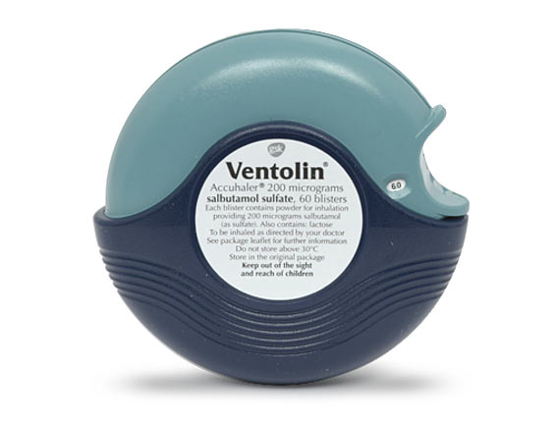
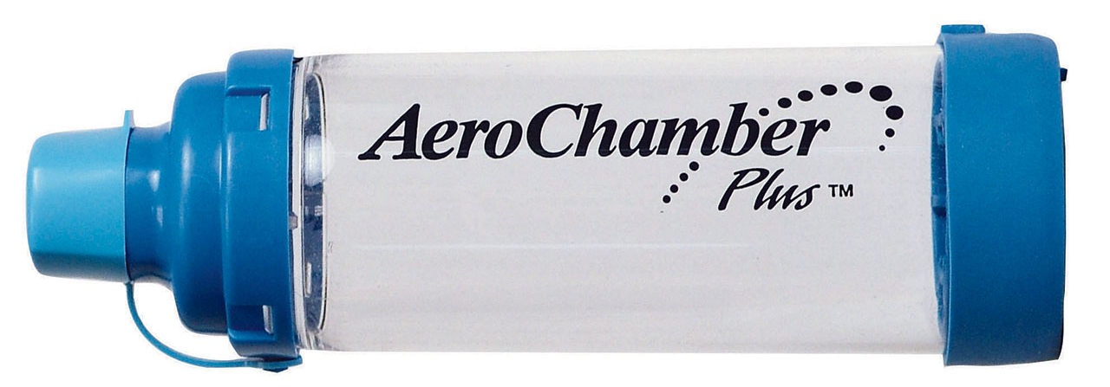
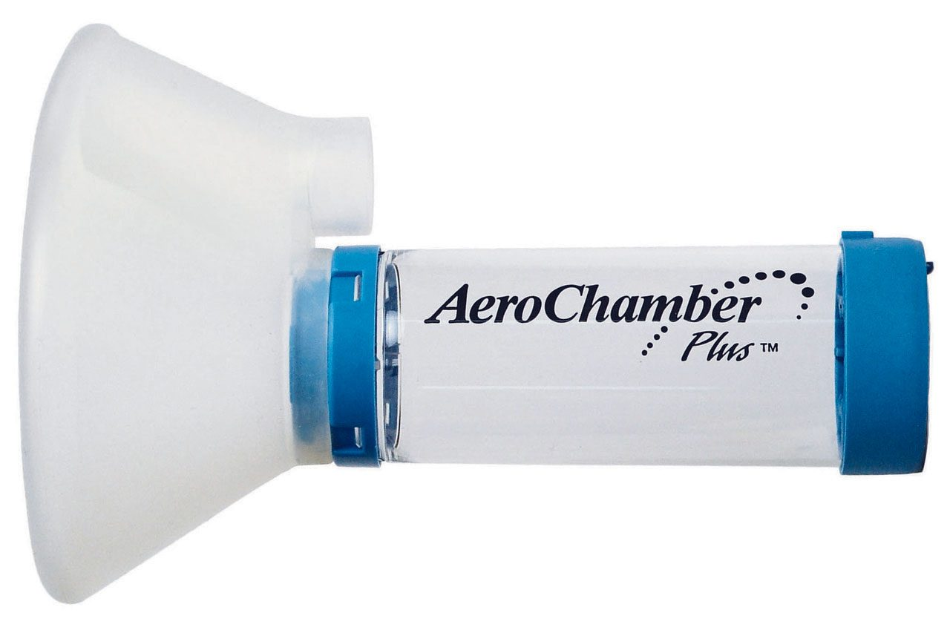
STEP 1: MAINTENANCE INHALERS – all contain inhaled corticosteroid (ICS) and should ALWAYS be prescribed with a PREVENTOR INHALER
TYPE | INHALER | PRESCRIBE | DEVICE INFORMATION | LICENSE AGE | ESTIMATED COST/1 YEAR | ESTIMATED CARBON FOOTPRINT PER INHALER (kgCO2eq)
METERED-DOSE INHALER (MDI) |  | Clenil 100mcg 1 puff BD | ALWAYS Prescribe with Spacer Dose Counter | 2+ | £27.01 Spacer should be replaced every 12 months | 20
METERED-DOSE INHALER (MDI) |  | Flixotide Evohaler 50mcg 1 puff BD | ALWAYS Prescribe with Spacer No Dose Counter | 4+ | £79.45 Spacer should be replaced every 12 months | 20
STEP 1: PRN RELIEVER INHALER – should ALWAYS be prescribed in combination with a MAINTENANCE INHALER. No child with suspected asthma should be given a SABA inhaler without an ICS inhaler.
DRY-POWDER INHALER (DPI) |  | Salbutamol Easyhaler 100mcg 1-2 puffs 4hrly PRN | Dose Counter | 4+ | £48.27 | <2
DRY-POWDER INHALER (DPI) |  | Ventolin Accuhaler 200mcg 1 puff 4hrly PRN | Dose Counter | 4+ | £87.36 | <2
METERED-DOSE INHALER (MDI) |  | Salbutamol (Generic) 100mcg 1-2 puffs 4hrly PRN | ALWAYS Prescribe with Spacer No Dose Counter | 4+ | £21.84 Spacer should be replaced every 12 months | 10
Please note that even when a child is able to use and is prescribed DPI inhalers, they must also be prescribed an MDI SABA inhaler and a spacer for specific use in asthmatic emergencies.
STEP 2: ADD LRTA – Annual cost £22.10 Age 12-14: Montelukast (chewable tablet) 5mg OD Age 15+: Montelukast 10mg OD
AEROCHAMBER
WITHOUT MASK
5+ YEARS
£4.99/year
AEROCHAMBER
WITH ADULT MASK
5+ YEARS
£8.33/year
Reference - NICE Guideline NG80 ‘Asthma: diagnosis, monitoring and chronic asthma management’ (https://www.nice.org.uk/guidance/ng80)

Slide 4
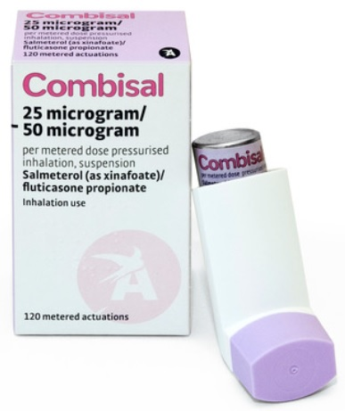
STEP 3: ICS/LABA COMBINATION INHALER – should replace patient’s existing ICS (Step 1) inhaler
TYPE | INHALER | PRESCRIBE | INFO | LICENSE AGE | ESTIMATED COST/1 YEAR | ESTIMATED CARBON FOOTPRINT PER INHALER (kgCO2eq)
DRY-POWDER INHALERS (DPI) |  | Duoresp Spiromax (Budesonide & Formoterol) 160/4.5mcg 1 puff BD | Dose Counter | 12+ | £169.98 | <2
DRY-POWDER INHALERS (DPI) |  | Relvar Ellipta (Fluticasone & Vilanterol) 99/22 1 puff OD | Dose Counter | 12+ | £266.93 | <2
DRY-POWDER INHALERS (DPI) |  | Symbicort Turbohaler (Budesonide & Formoterol) 100/6 2 puffs BD | Dose Counter | 6+ Licensed for MART regime age 12+ | £339.73 | <2
METERED-DOSE INHALERS (MDI) |  | Combisal (Fluticasone & Salmeterol) 50/25mcg 2 puffs BD | ALWAYS Prescribe with Spacer No Dose Counter | 4+ | £163.80 Spacer should be replaced every 12 months | 10-20
STEP 4: REFER TO SPECIALIST
Reference - NICE Guideline NG80 ‘Asthma: diagnosis, monitoring and chronic asthma management’ (https://www.nice.org.uk/guidance/ng80)

